Slide 1

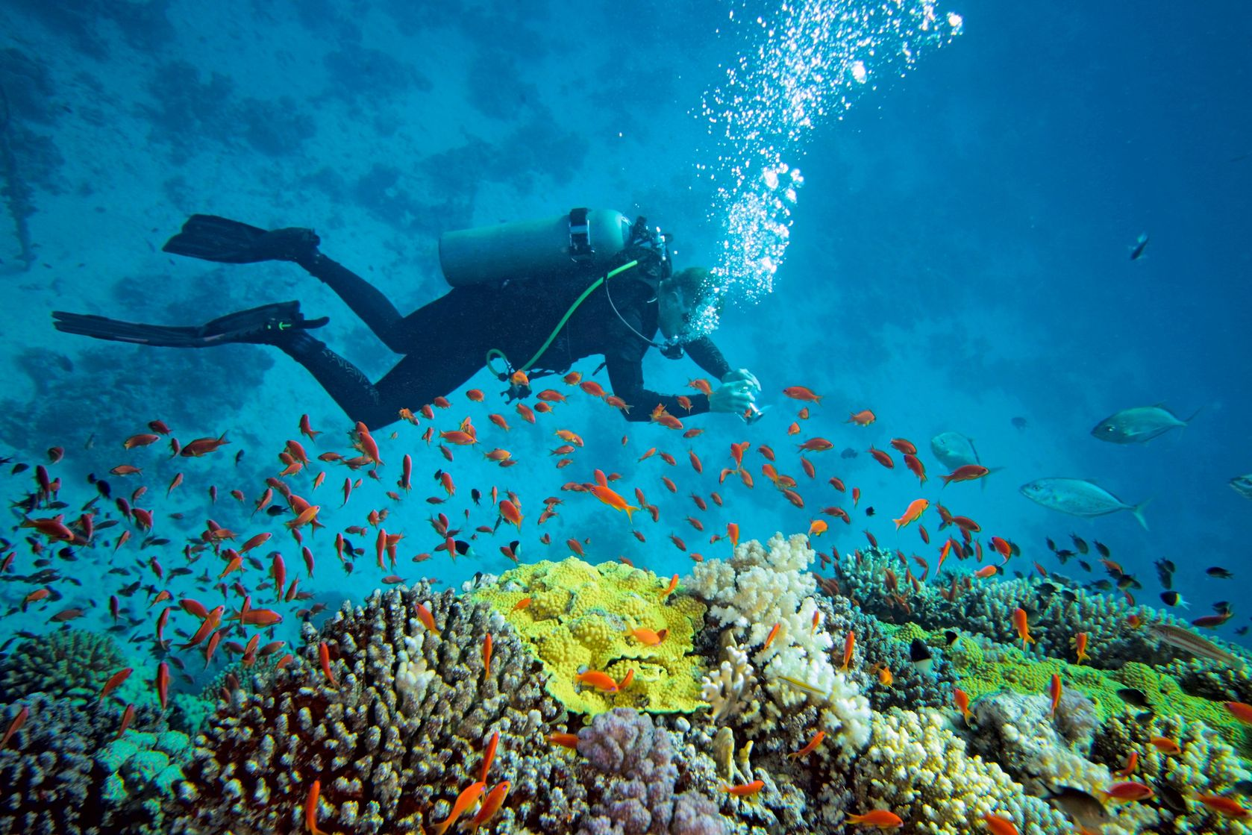
Security Application Via Engineering AS (SAVE)

Slide 2
Stakeholder requirements
Stakeholders | Requirements | SH code
User | The system should be user-friendly. | SHR1
 | The system should be reliable. | SHR2
 | The system should be safe. | SHR3
 | The system should be cheap. | SHR4
Designer | The system should be practical. | SHR5
 | The system should be profitable. | SHR6
Manufacture | The system should be easy to manufacture. | SHR7
Authority | The system should fulfil the regulations. | SHR8
Environment | The system should be pollution free. | SHR9
Insurance Compony | The system should be well documented to make it easy to asses risk-evaluation | SHR10
Maintenance | The system should assemble in a maintenance friendly manner. | SHR11
 | The system should durable regarding wear and tear. | SHR12
Re-cycling compony | The system should be reusable. | SHR13

Slide 3
Validation strategy
Step 1- Confirmation of adequacy of translation of perceived need or opportunity into stakeholder requirements
Step 2- Confirmation of the appropriateness of the selection of the preferred design concept
Step 3- Passing of the Critical Design Review
Step 4- Passing of the system acceptance tests (and continuous performance assessment during the operational life)
Formal reviews:
Step 1- The stakeholder requirements have to be reviewed. It should be confirmed that the set of requirements reflects
the perceived need or opportunity otherwise, we can not get the customers satisfaction.
Step 2- Approval of preferred design concept, because we want the optimal design concept.
Step 3- Customer presentation with all the design documentation and with the results of the methods run to verify the fulfillment of the system requirements to show that the customer requirements are well understood and the product is designed according to need.
Step 4- Conduction of performance of the acceptance tests to make sure that the customer accepts the product according to it’s expectation.

Slide 4
Identified stakeholders
Stakeholders | Requirements | Reason
User | The system should be user-friendly. | The main stakeholder who utilize/benefit the system
 | The system should be reliable.
 | The system should be safe.
 | The system should be cheap.
Designer | The system should be practical. | Persons who design/provide the system
 | The system should be profitable.
Manufacture | The system should be easy to manufacture. | Party/institure who make the system
Authority | The system should fulfil the regulations. | Party who set norm and regulations in term of utilization of system related to the environment
Environment | The system should be pollution free. | The place where the system will be utilized there
Insurance Compony | The system should be well documented to make it easy to asses risk-evaluation | Institute which recover/help the producer in case of broke or crisis
Maintenance | The system should assemble in a maintenance friendly manner. | Party who will maintane the system after delivery to the user
 | The system should durable regarding wear and tear.
Re-cycling compony | The system should be reusable. | Pary who will reuse the system after life cycle period

